Slide 1
Chapter 6:
MOMENTUM

Slide 2
This lecture will help you understand:
Momentum
Impulse
Impulse Changes Momentum
Bouncing
Conservation of Momentum
Collisions
More Complicated Collisions

Slide 3
Momentum
a property of moving things
means inertia in motion
more specifically, mass of an object multiplied by its velocity
in equation form:
  Momentum = mass × velocity

Slide 4
Momentum
A moving object can have a large momentum if it has a large mass, a high speed, or both.

Slide 5
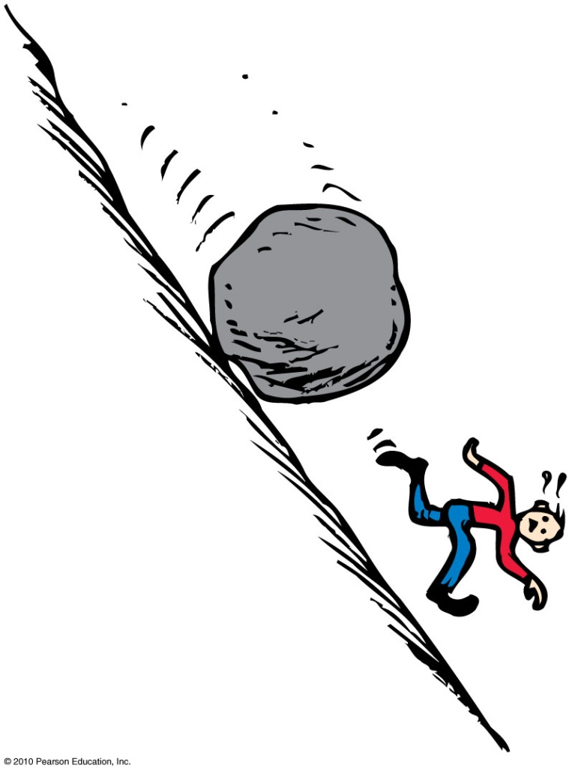
Momentum
Example:
  A moving boulder has more momentum than a stone rolling at the same speed.
  A fast boulder has more momentum than a slow boulder.
  A boulder at rest has no momentum.

Slide 6
A moving object has
Momentum
CHECK YOUR NEIGHBOR
A. momentum.
energy.
speed.
All of the above.
Notes:
D. all of the above.

Slide 7
A moving object has
Momentum
CHECK YOUR ANSWER
A. momentum.
energy.
speed.
All of the above.
Comment:
We will see in the next chapter that energy in motion is called kinetic energy.
Notes:
D. all of the above.

Slide 8
When the speed of an object is doubled, its momentum
Momentum
CHECK YOUR NEIGHBOR
A. remains unchanged in accord with the conservation of momentum.
doubles.
quadruples.
decreases.
Notes:
B. doubles.

Slide 9
When the speed of an object is doubled, its momentum
Momentum
CHECK YOUR ANSWER
A. remains unchanged in accord with the conservation of momentum.
doubles.
quadruples.
decreases.
Notes:
B. doubles.

Slide 10
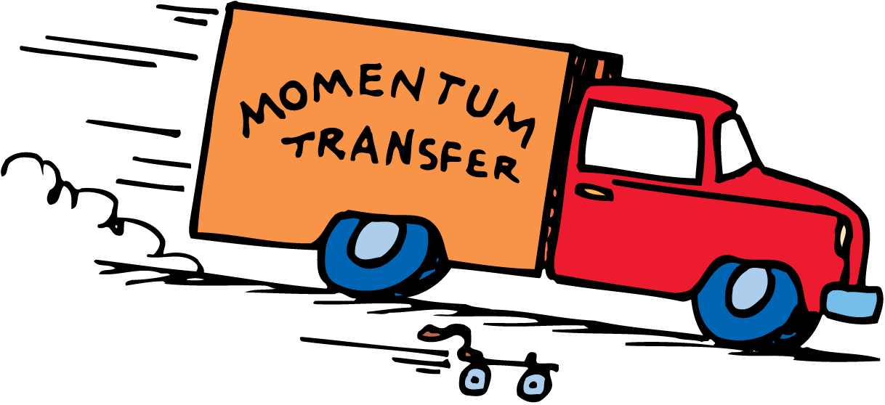
Momentum
A truck rolling down a hill has more momentum than a roller skate with the same speed. But if the truck is at rest and the roller skate moves, then the skate has more momentum.

Slide 11
Impulse
Product of force and time (force × time)
In equation form: Impulse = Ft
A force sustained for a long time produces more change in momentum than does the same force applied briefly.
Both force and time are important in changing an object’s momentum.
Example:
  A brief force applied over a short time interval produces a smaller change in momentum than the same force applied over a longer time interval.
or
  If you push with the same force for twice the time, you impart twice the impulse and produce twice the change in momentum.

Slide 12
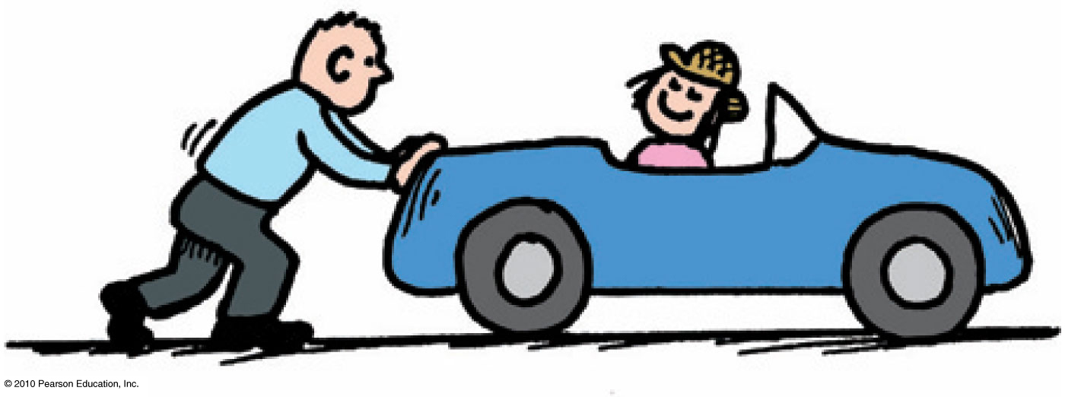
Impulse Changes Momentum
The greater the impulse exerted on something, the greater the change in momentum.
  In equation form: Ft = Δ(mv)

Slide 13
When the force that produces an impulse acts for twice as much time, the impulse is
Impulse Changes Momentum
CHECK YOUR NEIGHBOR
A. not changed.
doubled.
quadrupled.
halved.
Notes:
B. increased by twice.

Slide 14
When the force that produces an impulse acts for twice as much time, the impulse is
Impulse Changes Momentum
CHECK YOUR ANSWER
A. not changed.
doubled.
quadrupled.
halved.
Notes:
B. increased by twice.

Slide 15
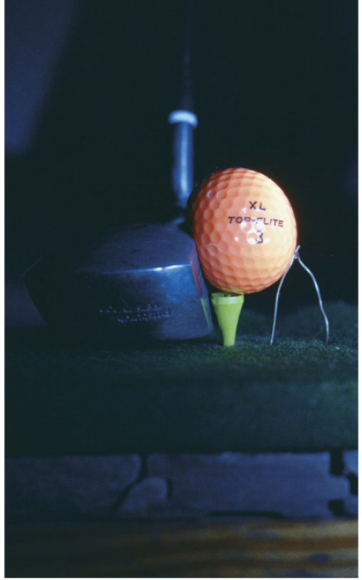
Impulse Changes Momentum
Case 1: increasing momentum
  Apply the greatest force for as long as possible and you extend the time of contact.
  Force can vary throughout the duration of contact.
  Examples:
    Golfer swings a club and
    follows through.
    Baseball player hits a ball and
    follows through.

Slide 16
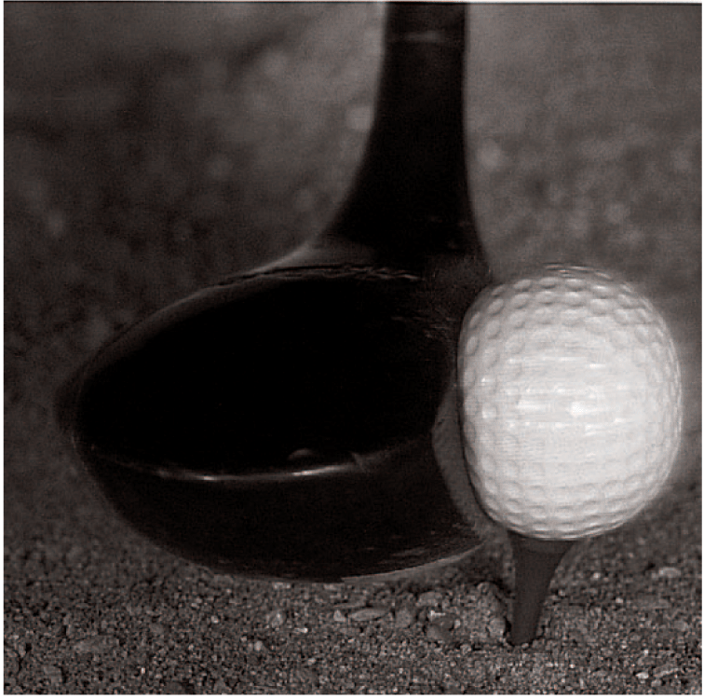
The force of impact on a golf ball varies throughout the duration of impact.
The forces involved in impulses usually vary from instant to instant.
  A golf club that strikes a golf ball exerts zero force on the ball until it comes in contact with it.
  The force increases rapidly as the ball becomes distorted.
  The force diminishes as the ball comes up to speed and returns to its original shape.
  We can use the average force to solve for the impulse on an object.

Slide 17
A cannonball shot from a cannon with a long barrel will emerge with greater speed because the cannonball receives a greater
Impulse Changes Momentum
CHECK YOUR NEIGHBOR
A. average force.
impulse.
Both of the above.
None of the above.
Notes:
B. impulse.

Slide 18
A cannonball shot from a cannon with a long barrel will emerge with greater speed because the cannonball receives a greater
Impulse Changes Momentum
CHECK YOUR ANSWER
A. average force.
impulse.
Both of the above.
None of the above.
Explanation:
The average force on the cannonball will be the same for a short- or long-barreled cannon. The longer barrel provides for a longer time for the force to act, and therefore, a greater impulse. (The long barrel also provides a longer distance for the force to act, providing greater work and greater kinetic energy to the cannonball.)
Notes:
B. impulse.

Slide 19
Impulse Changes Momentum
Case 2: If you were in a car that was out of control and had to choose between hitting a haystack or a concrete wall, you would choose the haystack.
Physics helps you to understand why hitting a soft object is entirely different from hitting a hard one.
decreasing momentum over a long time
  extend the time during which momentum is reduced

Slide 20
A fast-moving car hitting a haystack or a cement wall produces vastly different results.
1. Do both experience the same change in momentum?
2. Do both experience the same impulse?
3. Do both experience the same force?
Impulse Changes Momentum
CHECK YOUR NEIGHBOR
A. Yes for all three
Yes for 1 and 2
No for all three
No for 1 and 2
Notes:
B. Yes for 1 and 2.

Slide 21
A fast-moving car hitting a haystack or hitting a cement wall produces vastly different results.
1. Do both experience the same change in momentum?
2. Do both experience the same impulse?
3. Do both experience the same force?
Impulse Changes Momentum
CHECK YOUR ANSWER
A. Yes for all three
Yes for 1 and 2
No for all three
No for 1 and 2
Explanation:
Although stopping the momentum is the same whether done slowly or quickly, the force is vastly different. Be sure to distinguish among momentum, impulse, and force. -When hitting either the wall or the haystack and coming to a stop, the momentum is decreased by the same impulse.
  The same impulse does not mean the same amount of force or the same amount of time.
  It means the same product of force and time.
  To keep the force small, we extend the time.
Notes:
B. Yes for 1 and 2.

Slide 22
Impulse Changes Momentum
For a given change in momentum (impulse) When you extend the time, you reduce the force.
  A padded dashboard in a car is safer than a rigid metal one.
  Airbags save lives.
  To catch a fast-moving ball, extend your hand forward and move it backward after making contact with the ball.

Slide 23
When a dish falls, will the change in momentum be less if it lands on a carpet than if it lands on a hard floor? (Careful!)
Impulse Changes Momentum
CHECK YOUR NEIGHBOR
A. No, both are the same.
Yes, less if it lands on the carpet.
No, less if it lands on a hard floor.
No, more if it lands on a hard floor.
Notes:
A. No, both are the same.

Slide 24
When a dish falls, will the change in momentum be less if it lands on a carpet than if it lands on a hard floor? (Careful!)
Impulse Changes Momentum
CHECK YOUR ANSWER
A. No, both are the same.
Yes, less if it lands on the carpet.
No, less if it lands on a hard floor.
No, more if it lands on a hard floor.
Explanation:
The momentum becomes zero in both cases, so both change by the same amount. Although the momentum change and impulse are the same, the force is less when the time of momentum change is extended. Be careful to distinguish among force, impulse, and momentum.
Notes:
A. No, both are the same.

Slide 25
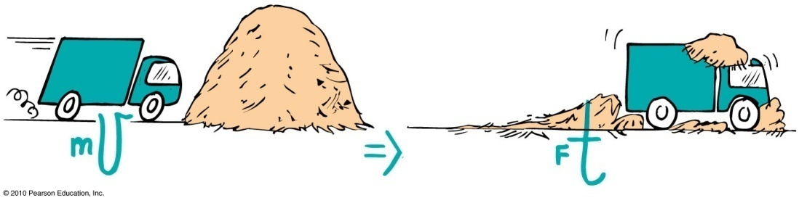
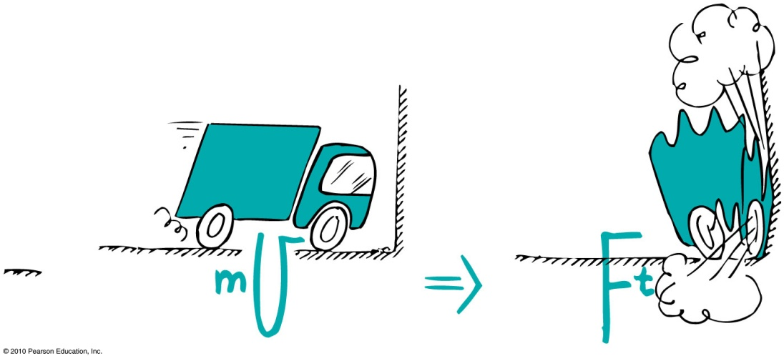
Impulse Changes Momentum
Examples:
  When a car is out of control, it is better to hit a haystack than a concrete wall.
Physics reason: Same impulse either way, but extension of hitting time reduces the force.

Slide 26
Impulse Changes Momentum
  Example (continued):
    When jumping, (or landing from a sky dive) bend your knees when your feet make contact with the ground because the extension of time during your momentum decrease reduces the force on you.

Slide 27
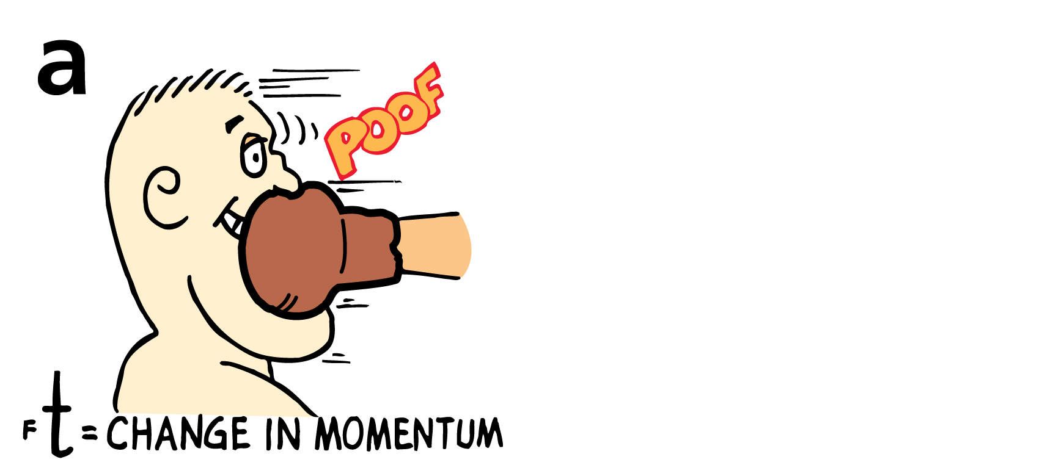
Impulse Changes Momentum
The impulse provided by a boxer’s jaw counteracts the momentum of the punch.
a. The boxer moves away from the punch.

Slide 28
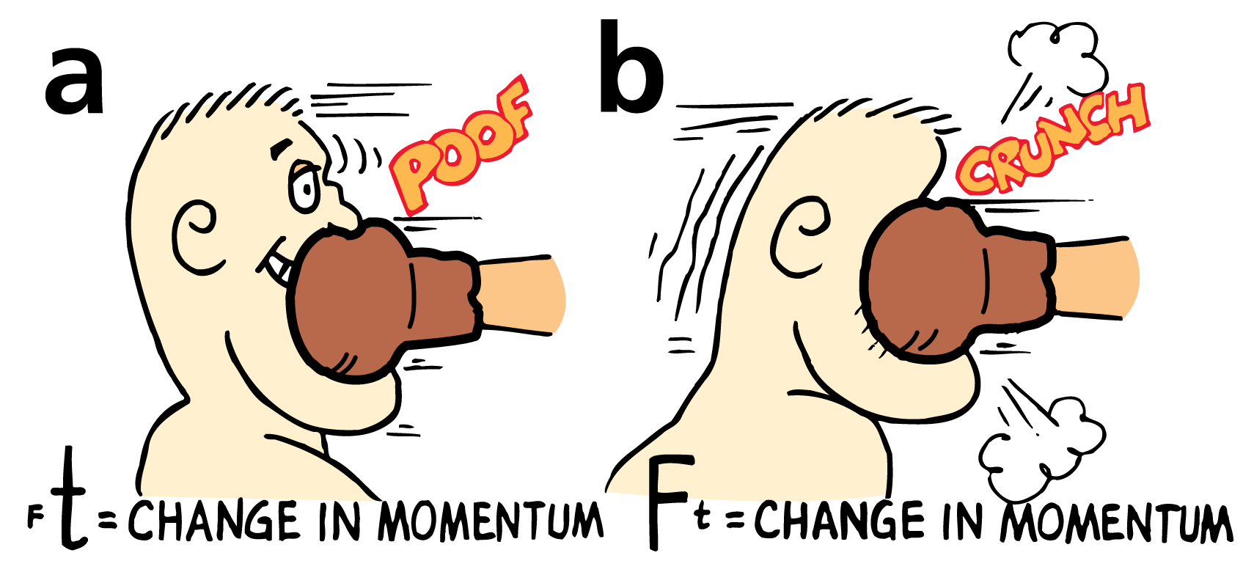
Impulse Changes Momentum
The impulse provided by a boxer’s jaw counteracts the momentum of the punch.
a. The boxer moves away from the punch.
b. The boxer moves toward the punch. Ouch!

Slide 29
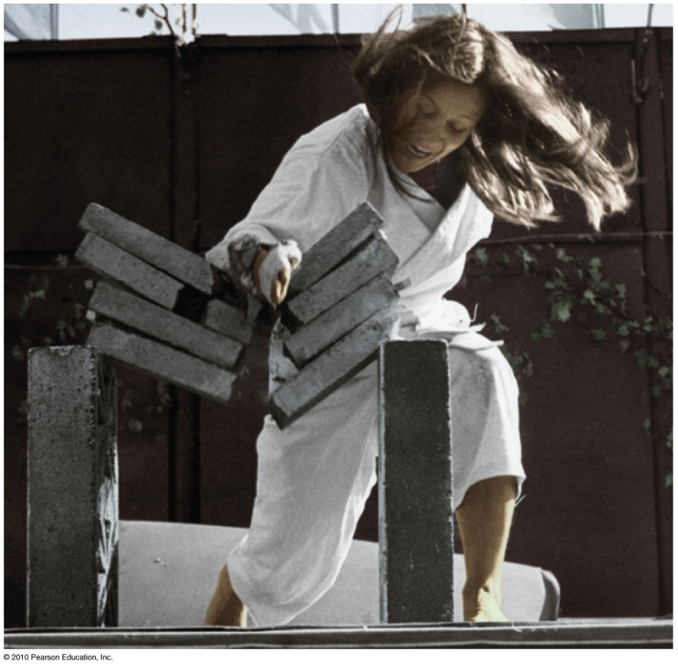
Impulse Changes Momentum
Case 3: decreasing momentum over a short time
  short time interval produces large force.
  Example: Karate expert splits a
  stack of bricks by bringing her arm and hand swiftly against
  the bricks with considerable
  momentum. Time of contact is
  brief and force of impact is huge.

Slide 30
Bouncing
Impulses are generally greater when objects bounce.
Example:
  Catching a falling flower pot from a shelf with your hands. You provide the impulse to reduce its momentum to zero. If you throw the flower pot up again, you provide an additional impulse. This “double impulse” occurs when something bounces.
The impulse required to bring an object to a stop and then to “throw it back again” is greater than the impulse required merely to bring the object to a stop.

Slide 31
Bouncing
Suppose you catch a falling pot with your hands.
  You provide an impulse to reduce its momentum to zero.
  If you throw the pot upward again, you have to provide additional impulse.

Slide 32
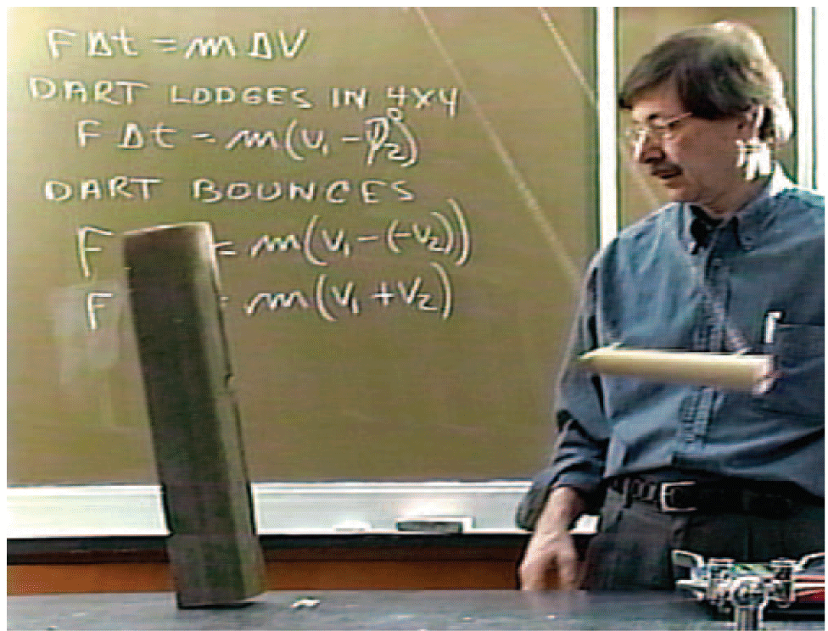
8.3 Bouncing
The block topples when the swinging dart bounces from it. Without the rubber head of the dart, it doesn’t bounce when it hits the block and no toppling occurs.

Slide 33
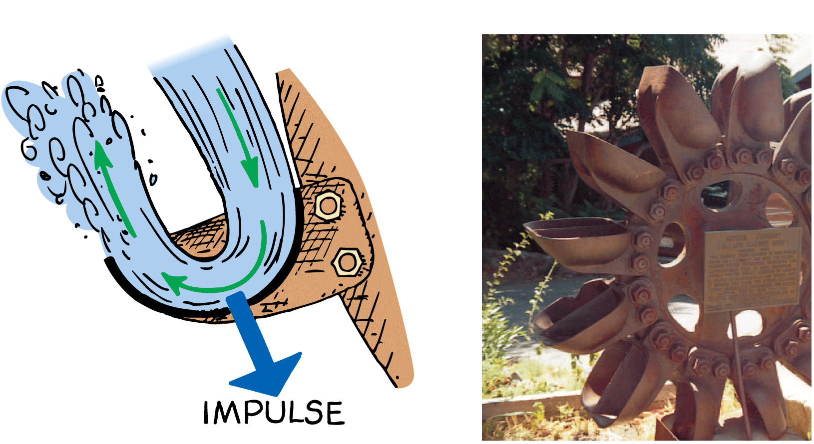
Bouncing
Pelton wheel designed to “bounce” water when it makes a U-turn on impact with the curved paddle

Slide 34
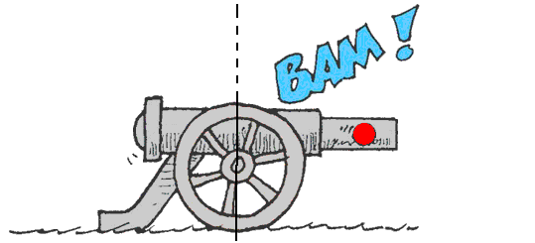
Conservation of Momentum
Law of conservation of momentum:
  In the absence of an external force, the momentum of a system remains unchanged.

Slide 35
8.4 Conservation of Momentum
The force on the cannonball inside the cannon barrel is equal and opposite to the force causing the cannon to recoil. The action and reaction forces are internal to the system so they don’t change the momentum of the cannon-cannonball system.
  Before the firing, the momentum is zero.
  After the firing, the net momentum is still zero.
  Net momentum is neither gained nor lost.

Slide 36
Conservation of Momentum
Examples:
    When a cannon is fired, the force on the cannonball inside the cannon barrel is equal and opposite to the force of the cannonball on the cannon.
    The cannonball gains momentum, while the cannon gains an equal amount of momentum in the opposite direction—the cannon recoils.
  When no external force is present, no external impulse is present, and no change in momentum is possible.

Slide 37
Conservation of Momentum
  Examples (continued):
    Internal molecular forces within a baseball come in pairs, cancel one another out, and have no effect on the momentum of the ball.
    Molecular forces within a baseball have no effect on its momentum.
    Pushing against a car’s dashboard has no effect on its momentum.

Slide 38
Collisions
For all collisions in the absence of external forces,
  net momentum before collision equals net momentum after collision.
  in equation form:
(net mv)_{before} = (net mv)_{after}

Slide 39
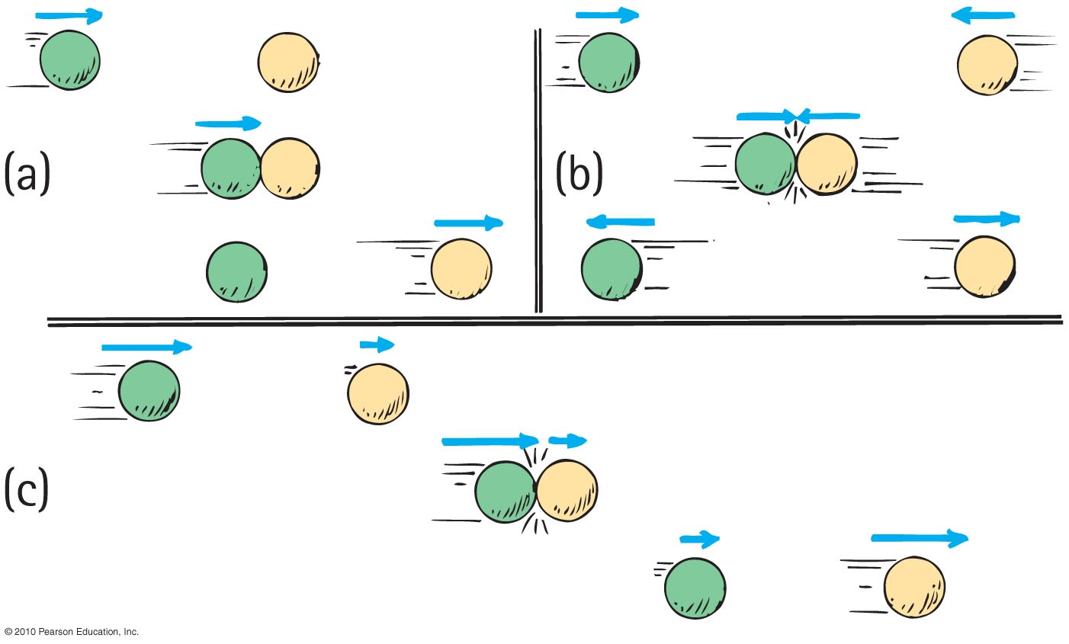
Collisions
Elastic collision
  occurs when colliding objects rebound without lasting deformation or any generation of heat.

Slide 40
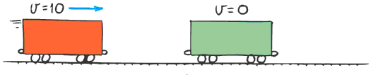
Collisions
Inelastic collision
  occurs when colliding objects result in deformation and/or the generation of heat.

Slide 41
Collisions
Example of elastic collision:
single car moving at 10 m/s collides with another car of the same mass, m, at rest
From the conservation of momentum,
(net mv)_{before} = (net mv)_{after}
(m × 10)_{before} = (2m × V)_{after}
V = 5 m/s

Slide 42
Freight car A is moving toward identical freight car B that is at rest. When they collide, both freight cars couple together. Compared with the initial speed of freight car A, the speed of the coupled freight cars is
Collisions
CHECK YOUR NEIGHBOR
A. the same.
half.
twice.
None of the above.
Notes:
B. half.

Slide 43
Freight car A is moving toward identical freight car B that is at rest. When they collide, both freight cars couple together. Compared with the initial speed of freight car A, the speed of the coupled freight cars is
Collisions
CHECK YOUR ANSWER
A. the same.
half.
twice.
None of the above.
Explanation:
After the collision, the mass of the moving freight cars has doubled. Can you see that their speed is half the initial velocity of freight car A?
Notes:
B. half.

Slide 44
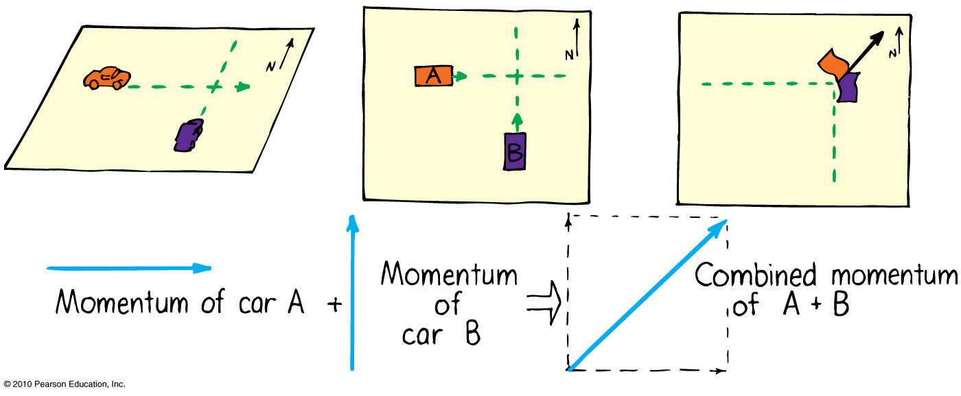
More Complicated Collisions
Sometimes the colliding objects are not moving in the same straight line.
In this case you create a parallelogram of the vectors describing each initial momentum to find the combined momentum.
Example: collision of two cars at a corner

Slide 45
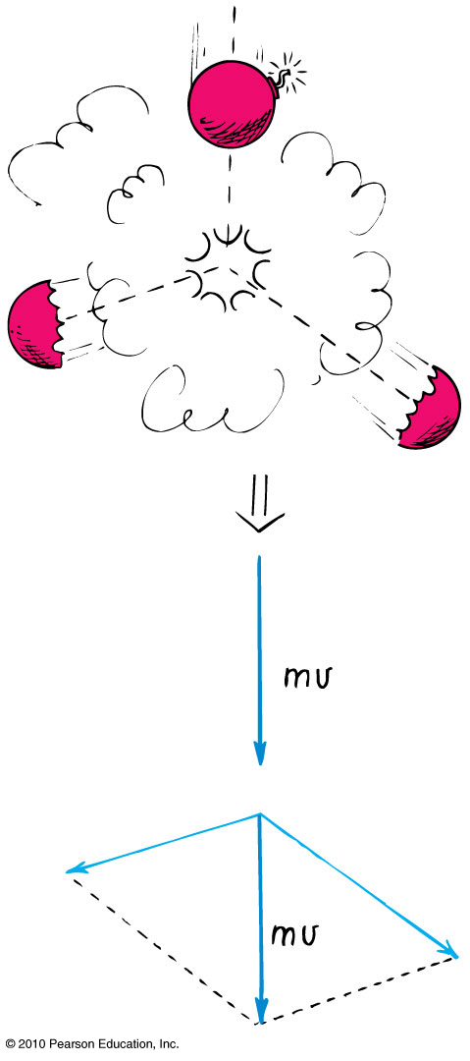
More Complicated Collisions
Another example:
A firecracker exploding; the total momentum of the pieces after the explosion can be added vectorially to get the initial momentum of the firecracker before it exploded.

Slide 46

Collisions
do the math!
Consider a 6-kg fish that swims toward and swallows a
2-kg fish that is at rest. If the larger fish swims at 1 m/s, what is its velocity immediately after lunch?
Momentum is conserved from the instant before lunch until the instant after (in so brief an interval, water resistance does not have time to change the momentum).

Slide 47
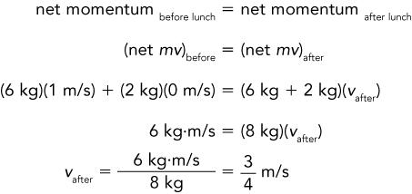
8.5 Collisions
do the math!

Slide 48
Collisions
do the math!
Suppose the small fish is not at rest but is swimming toward the large fish at 2 m/s.

Slide 49
8.5 Collisions
do the math!
Suppose the small fish is not at rest but is swimming toward the large fish at 2 m/s.
If we consider the direction of the large fish as positive, then the velocity of the small fish is –2 m/s.

Slide 50
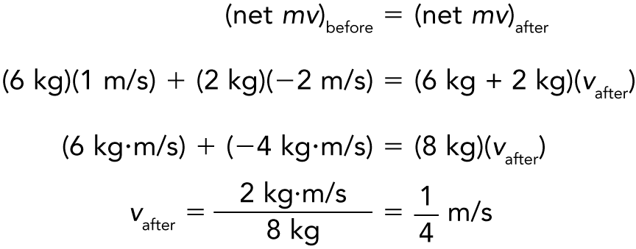
Collisions
do the math!
The negative momentum of the small fish slows the large fish.

Slide 51
Collisions
do the math!
If the small fish were swimming at –3 m/s, then both fish would have equal and opposite momenta.
Zero momentum before lunch would equal zero momentum after lunch, and both fish would come to a halt.

Slide 52
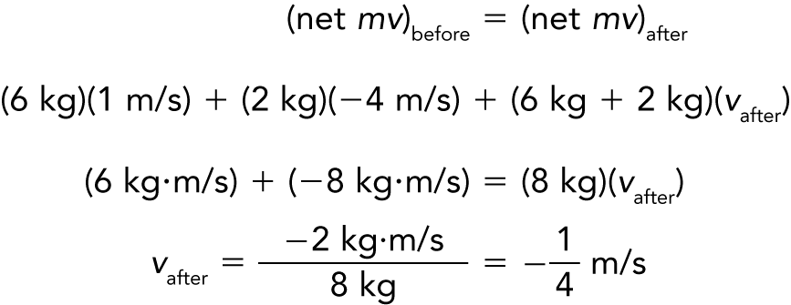
Collisions
do the math!
Suppose the small fish swims at –4 m/s.
The minus sign tells us that after lunch the two-fish system moves in a direction opposite to the large fish’s direction before lunch.

Slide 53
Chapter 6 Problems
2. Joanne drives her car with a mass of 1000 kg at a speed of 20 m/s. Show that to bring her car to a halt in 10 s road friction must exert a force of 2000 N on the car.
Since F t = Δmv, then F = Δmv/t = 1000 kg 20 m/s /10s
F = 2000 kg m /s²

Slide 54
Chapter 6 Problems
4. Judy (mass 40 kg), standing on slippery ice, catches her leaping dog (mass 15 kg) moving horizontally at 3.0 m/s. Show that the speed of Judy and her dog after the catch is 0.8 m/s.
momentum before = momentum after
(m_{Judy} + m_{dog} ) v_{after} = m_{Judy} v_{Judy} + m_{dog} v_{dog}
v_{after} = m_{dog} v_{dog} / (m_{Judy} + m_{dog} ) =
v_{after} = 15 kg 3.0 m/s / (40 kg + 15 kg)
v_{after} = 45 kg m/s / 55 kg = 0.8 m/s

Slide 55
Chapter 6 Problems
6A railroad diesel engine weighs four times as much as a freight car. If the diesel engine coasts at 5 km/h into a
freight car that is initially at rest show that the speed of the coupled cars is 4 km/h.
momentum before = momentum after
m_{diesel} v_{diesel} = (m_{diesel} + m_{car}) v_{after} = (m + m/4) v_{after}
5m_{diesel} /4 v_{after} = m_{diesel} 5 km/hr
v_{after} = 4 km/hr

Slide 56
Chapter 6 Problems
8. Comic-strip hero Superman meets an asteroid in outer space and hurls it at 800 m/s, as fast as a bullet. The
asteroid is a thousand times more massive than Superman. In the strip, Superman is seen at rest after
the throw. Taking physics into account, what would be his recoil velocity?
momentum before = momentum after
m_{Sman} v_{Sman} + m_{asteroid} v_{asteroid} = 0
and (m_{asteroid} / m_{man})= 1000
v_{Sman} = - (m_{asteroid} / m_{man})v_{asteroid} = - 1000 · 800 m/s
v_{Sman} = - 800,000 m/s

Slide 57
Chapter 6 Problems
10. An ostrich egg of mass m is tossed at a speed v into a sagging bed sheet and is brought to rest in a time t.
a. Show that the force acting on the egg when it hits the sheet is mv/t.
Since F t = Δmv then F = (m·0 + mv)/t = mv/t
b. If the mass of the egg is 1 kg, its initial speed is 2 m/s, and the time to stop is 0.2 s, show that the average force on the egg is 10 N.
F = 1 kg 2 m/s / 0.2s =10 kg m/s = 10 N.

